Slide 1

Social Media Analytics
Samarth Motka - 076
Krish Nasit – 077
Nirav Patel – 101
Yug Raithatha - 118

Slide 2
Objective
To perform data analysis and get insights from the texts exchanged over the WhatsApp which helps in taking real time decisions as well as align our operational efficiency with organizational strategy.

Slide 3
Data Source
WhatsApp chat: we have exported whatsapp chat with export whatsapp chat feature. However, we have not included media.
We have used libraries such as: Streamlit, pandas, Word Cloud, uRL extractor, Emojies

Slide 4
Data Collection
Streamlit
Pandas
Word Cloud
Emoji
URL extractor
To deploy web-based application
To create Data-frame
Text analysis and Regular Expression
Emoji Analysis
Differentiate between text and URL

Slide 5
Methodology
Extraction
Our product offers the style and function of traditional commercial spaces, but with a plan for energy efficiency.
Regular expression
Used to differentiate whatsapp notification, date time, etc
Data Analysis
Performed on chats of Whatsapp.
Data Visualization
A siample building that gives customers the space they need without the high cost of building maintenance.

Slide 6
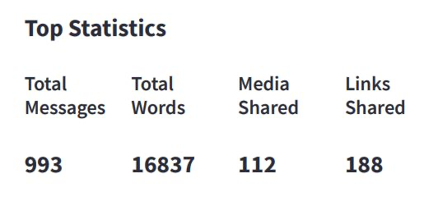
Analysis 1

Slide 7
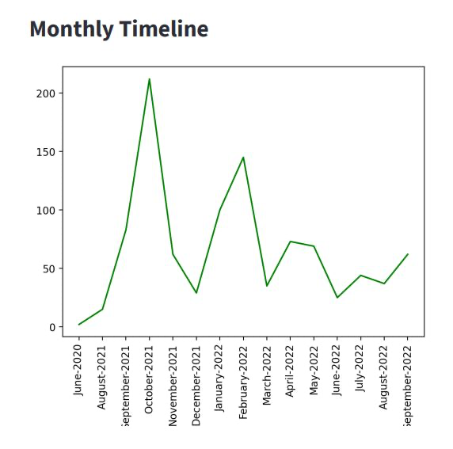
Analysis 2

Slide 8
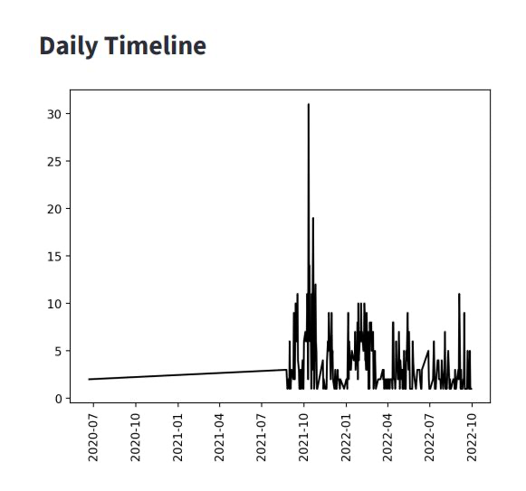
Analysis 3

Slide 9
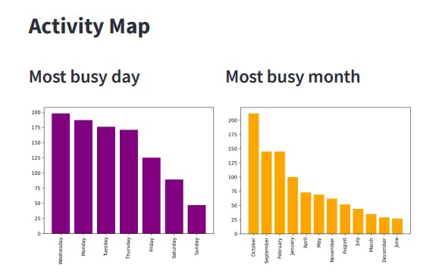
Analysis 4

Slide 10
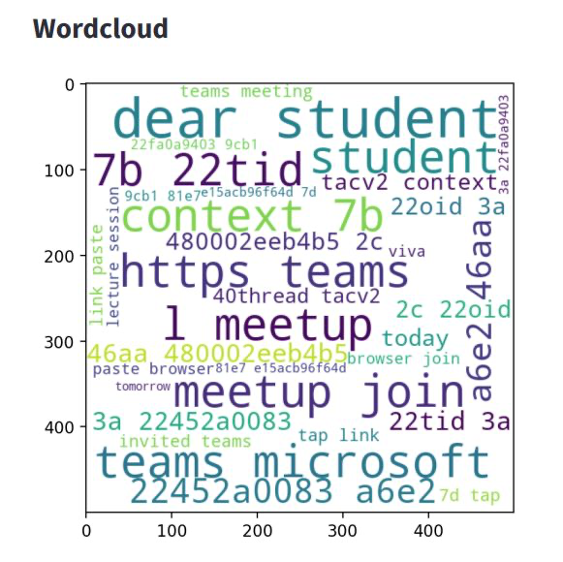
Analysis 5

Slide 11
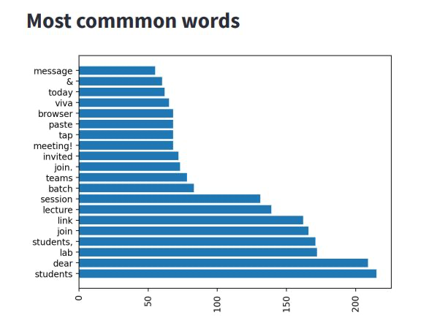
Analysis 6

Slide 12
Future Scope
We can perform data analysis on the data that we received.
We can also implement ml model on dataset
We can get sentiment analysis insights from the current project and apply the same for further research.

Slide 13
Thank You

